Slide 1
A journey toward single-cell RNA Sequencing
Guangyuan(Frank) Li
3rd year BMI PhD student

Slide 2
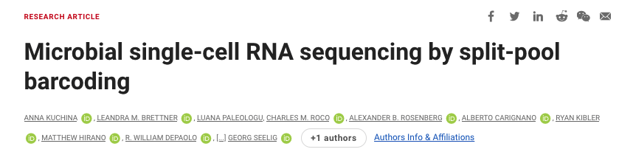
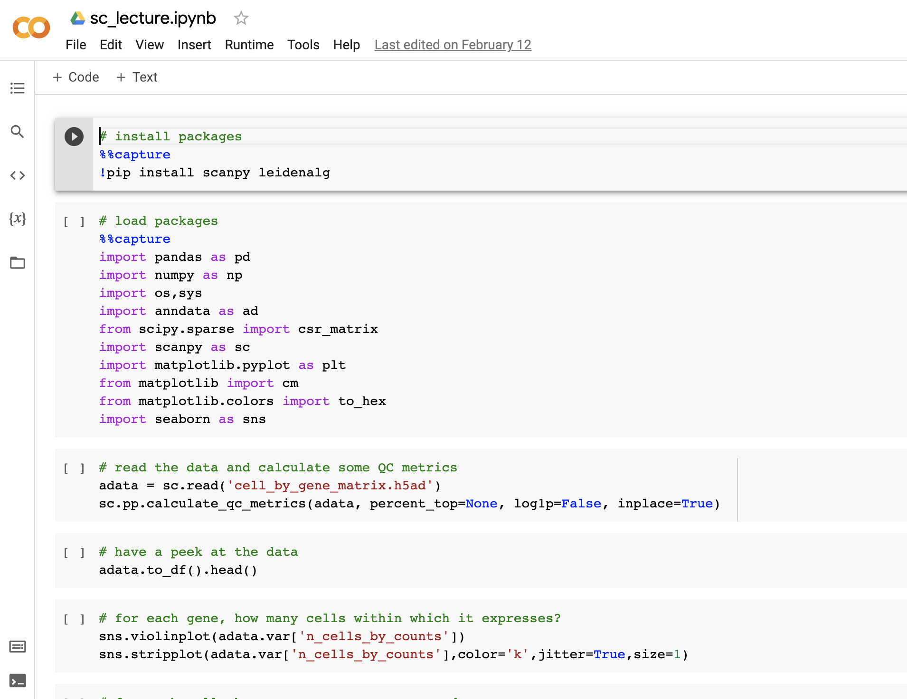
Agenda
Tuesday (theory)
What is single-cell RNA Sequencing?
How does it fit into the course?
What insights can we gain from scRNA?
Thursday (hands-on)

Slide 3
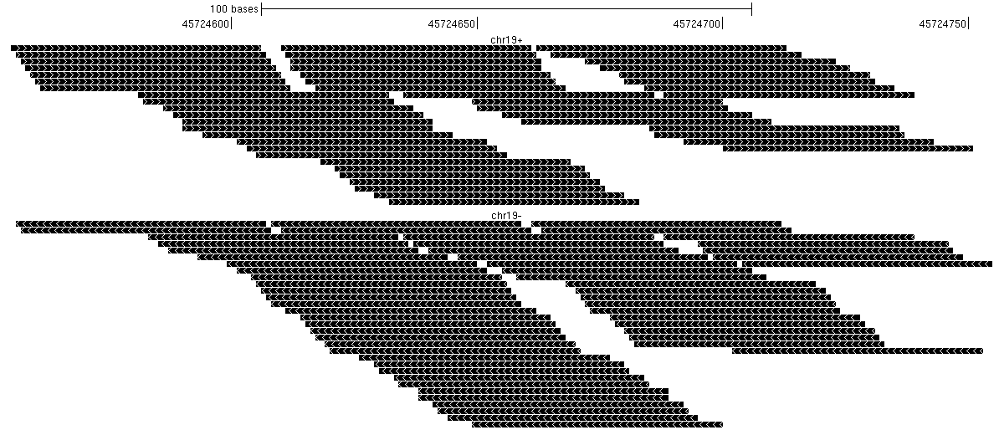
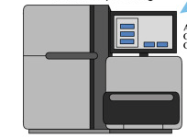

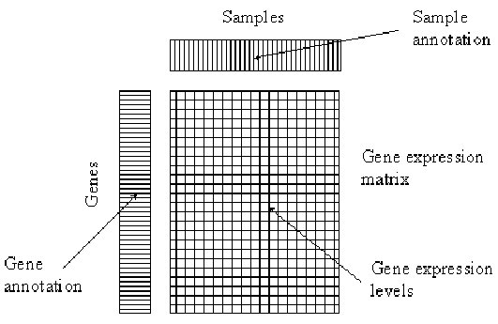
A recap of what we have done so far
Annotation
Alignment
Quantification

Slide 4
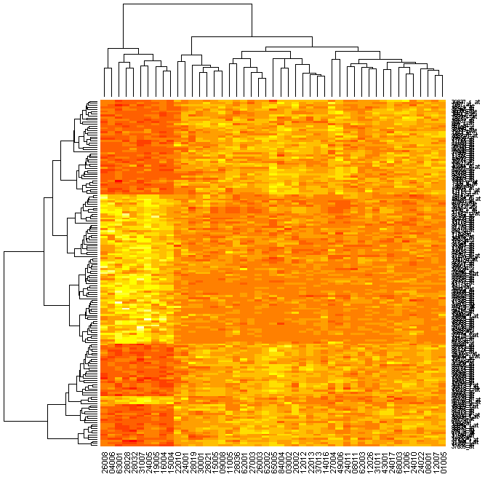
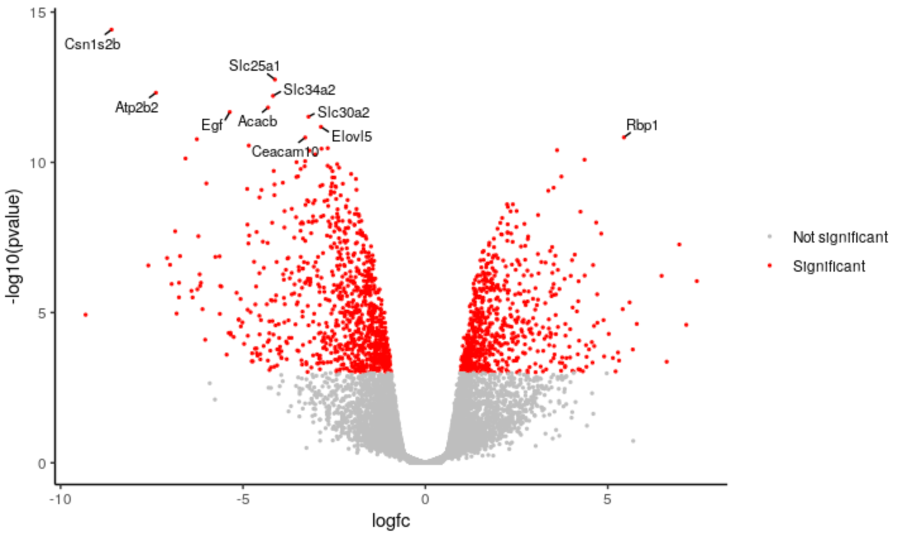
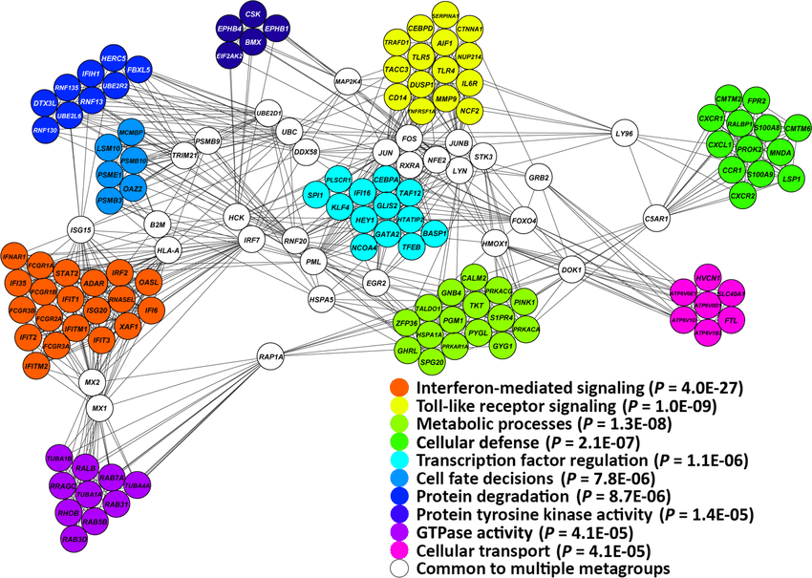
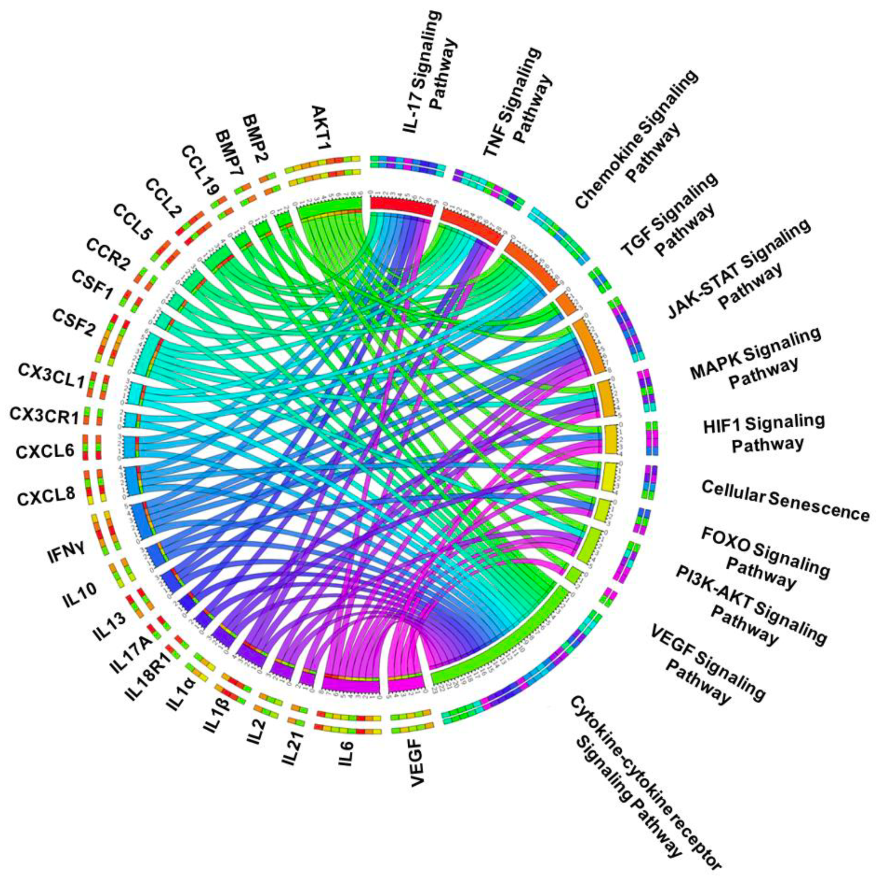
Downstream analysis that ensue
Differential genes
Network
Enrichment

Slide 5
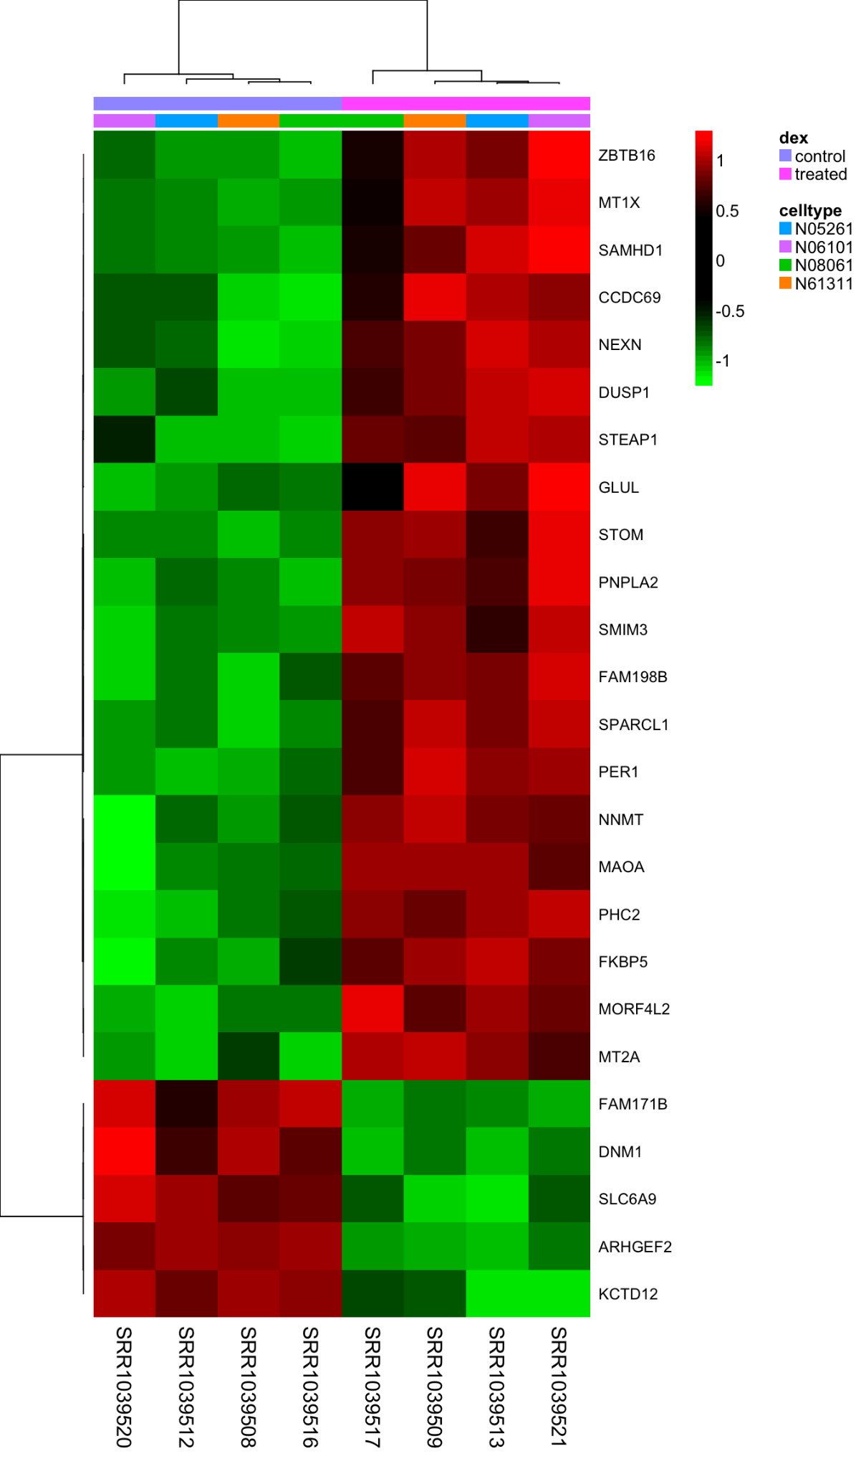
Bulk RNA Sequencing enables simultaneous measurements of all expressed genes
X-axis: effective size
Y-axis: statistical significance

Slide 6
Bulk RNA Sequencing reveals gene expression patterns and interactions

Slide 7
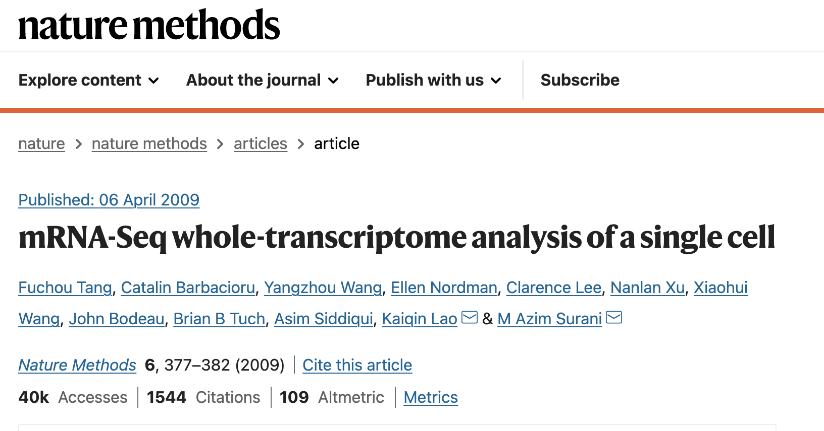
Bulk sequencing versus single-cell

Slide 8
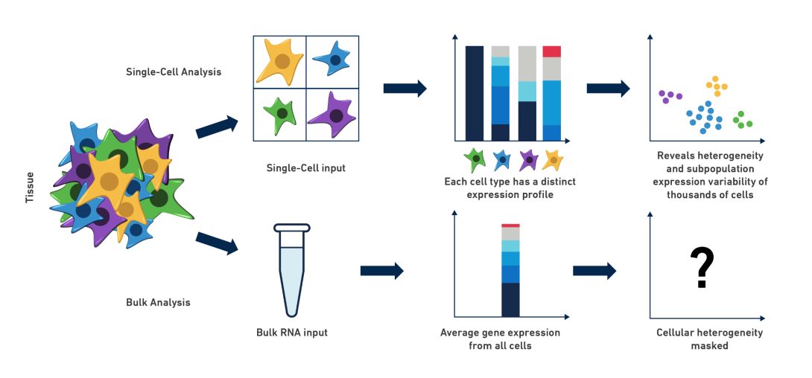
Bulk sequencing versus single-cell
Reveal further heterogeneity

Slide 9
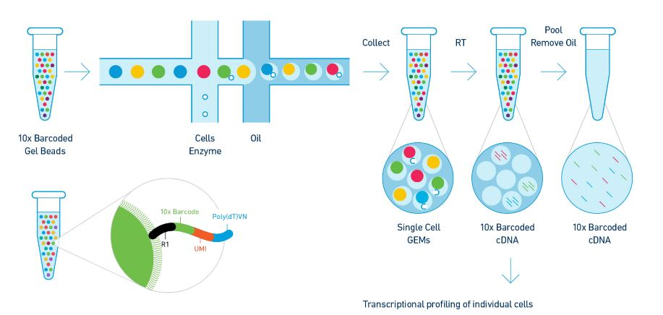
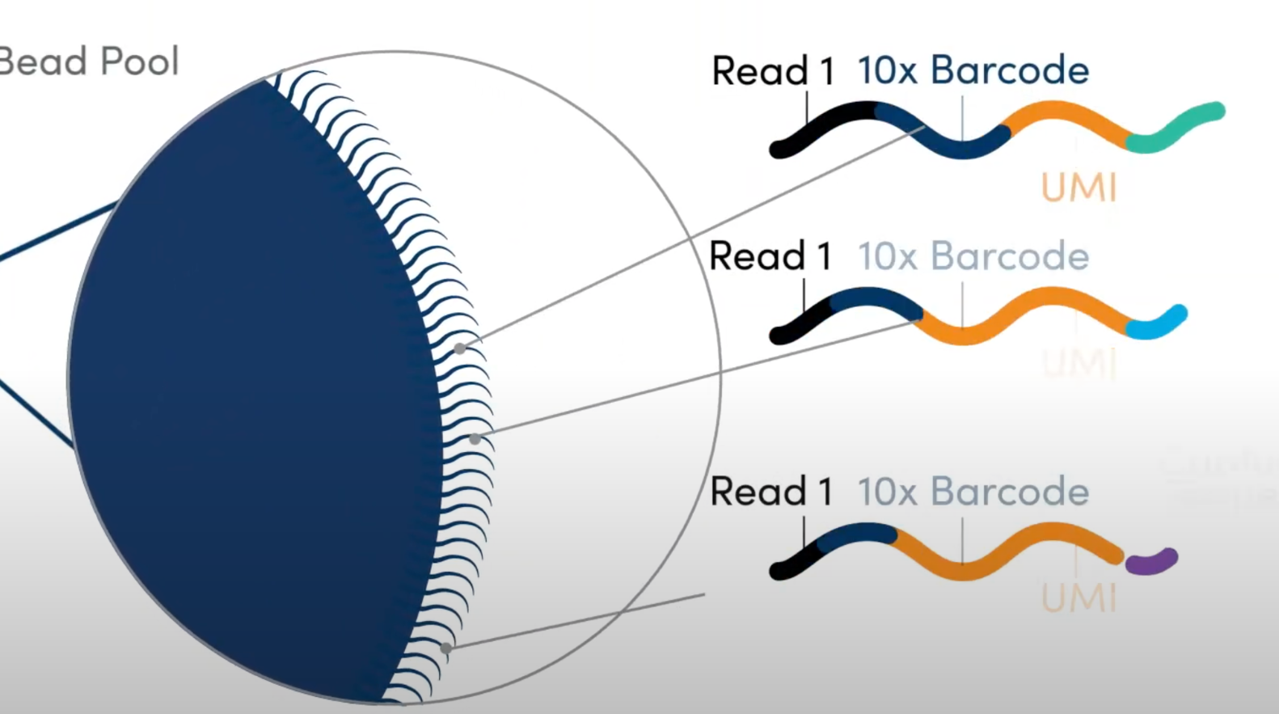
How Does single-cell RNA Sequencing work (Multiplexing)?

Slide 10
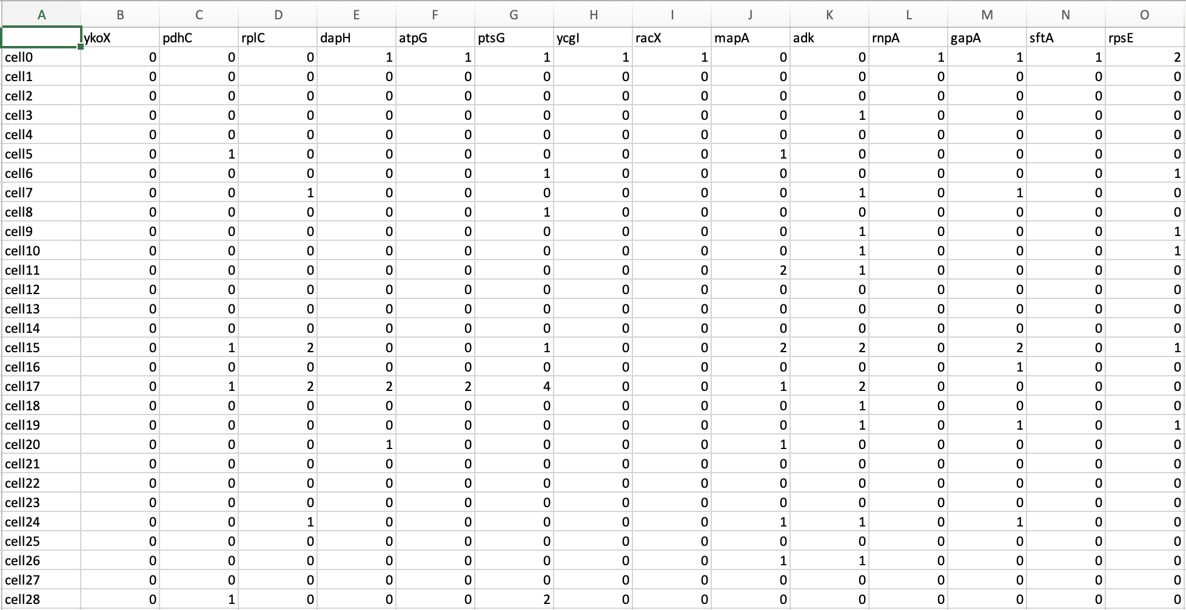
A glance at single-cell RNA gene matrix
genes
cells

Slide 11
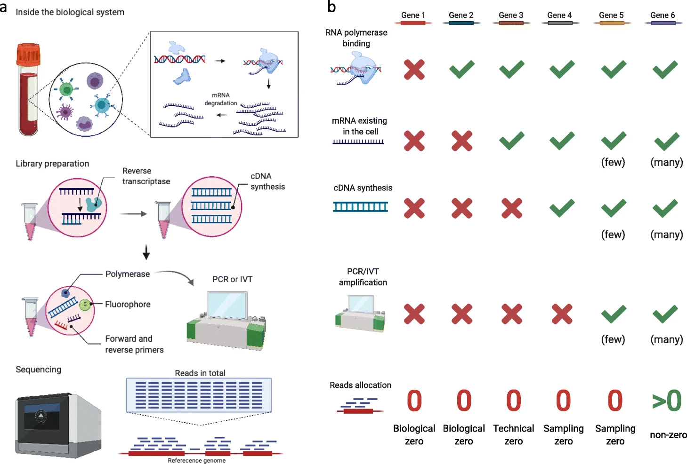
Sparsity issues – the sources, the complexities

Slide 12
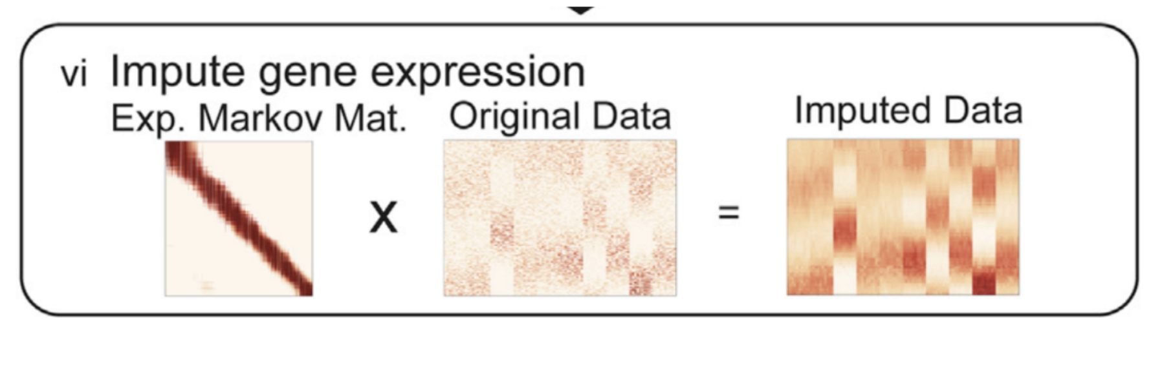
Sparsity issues – the sources, the complexities
Computational imputation
Univariate imputation (i.e. mean, median, mode)
Multivariate imputation (i.e. regression, KNN) [Borrow information from similar data]
It is debatable whether imputation would be beneficial in single-cell field
Imputation introduces artificial bias basing off of the statistical assumptions
Values that are present are sufficient for us to infer similarities between cells

Slide 13
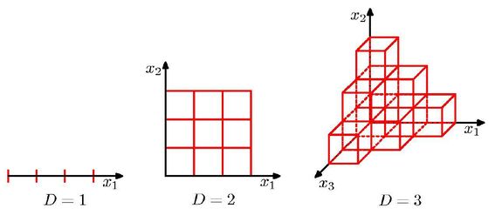
Curse of dimensionality and dimension reduction algorithms
A single-cell dataset can easily become more than 100k cells (20,000 genes * 100k cells)
Curse of dimensionality
The same amount of observations in low dimension is not sufficient to describe the same configuration (regular grid) in higher dimension space

Slide 14
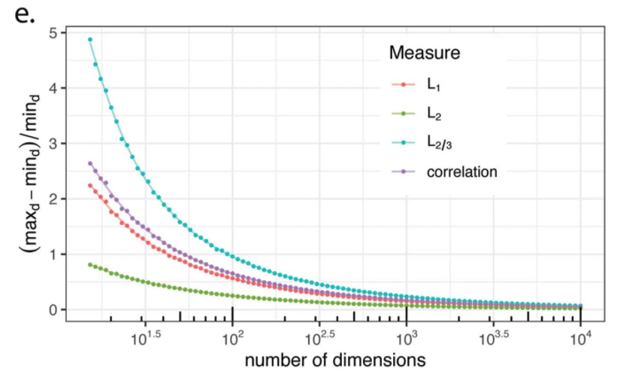
Curse of dimensionality and dimension reduction algorithms
A single-cell dataset can easily become more than 100k cells (20,000 genes * 100k cells)
Curse of dimensionality
traditional distance metrics fall short of measuring similarities

Slide 15
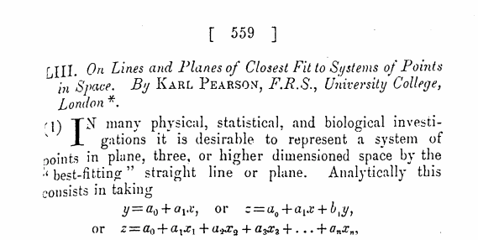
Dimension reduction algorithms - Principal component analysis (PCA)
PEARSON, Karl, 1901. On lines and planes of closest fit to systems of points in space, Philosophical Magazine, Series 6, vol. 2, no. 11, pp. 559-572

Slide 16
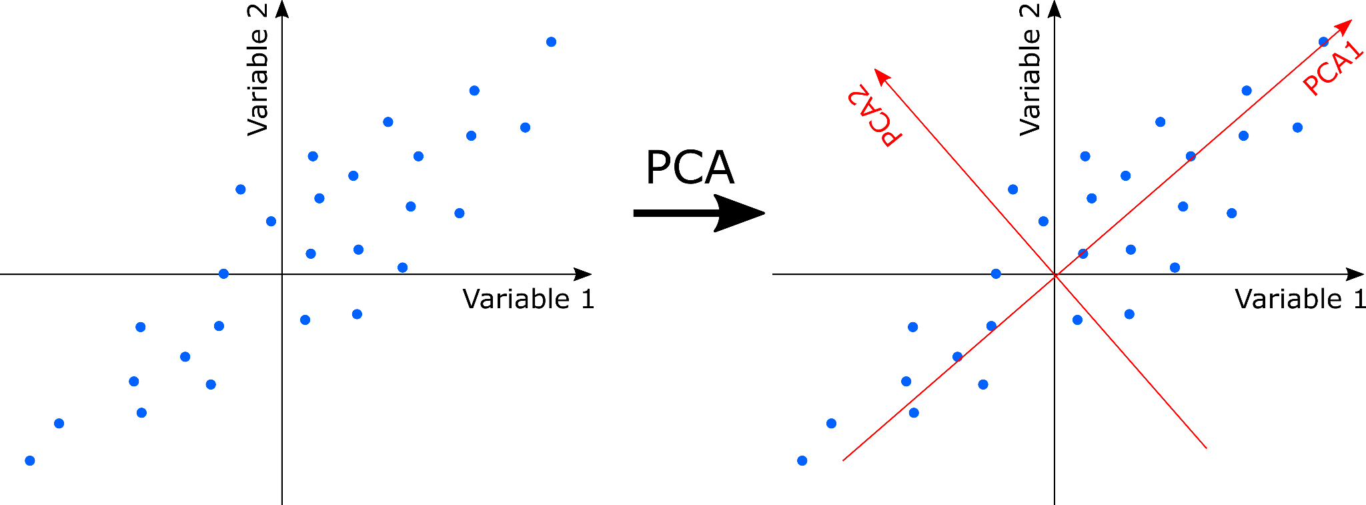
Dimension reduction algorithms - Principal component analysis (PCA)
Find orthogonal sets of axes that explain the most of the variation
https://en.wikipedia.org/wiki/Principal_component_analysis

Slide 17
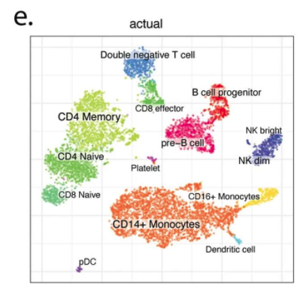
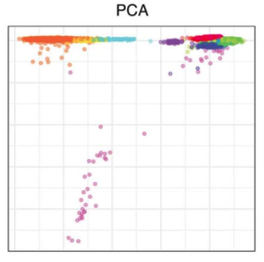
Dimension reduction algorithms - Principal component analysis (PCA)
Find orthogonal sets of axes that explain the most of the variation

Slide 18
Curse of dimensionality and dimension reduction algorithms
Reducing dimension can alleviate the potential “curse of dimensionality” problem
Dimension reduction aims to find a low-rank approximation
Drastically decreasing the computational costs and time

Slide 19
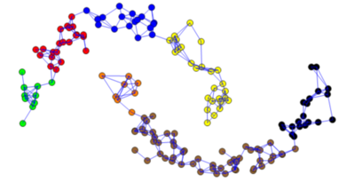
k-Nearest Neighbor (KNN) Graph to represent cell-cell similarities
Calculating pairwise distance based on traditional distance metrics on reduced PCs
Add an edge between cell A and cell B if the cell B happens to be one of the cell A’s k-nearest neighbors

Slide 20
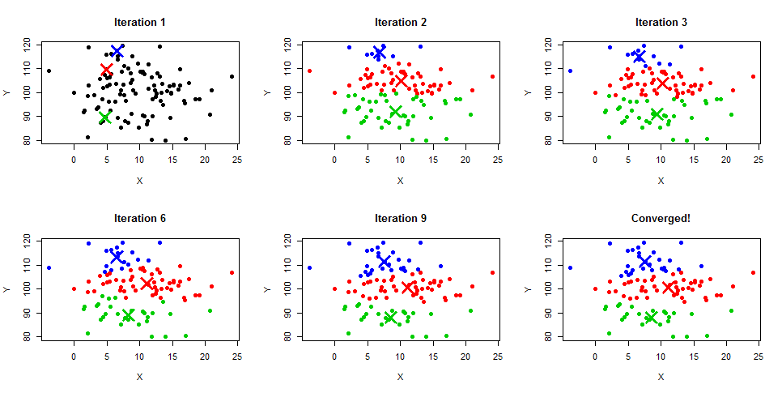
Clustering on the KNN graph to define cell populations
Can we use k-means clustering?

Slide 21
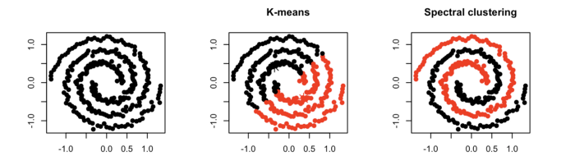
Clustering on the KNN graph to define cell populations
Drawbacks of k-means clustering:
Not suitable for non-convex shaped clusters
Consider compactness but not connectivity

Slide 22
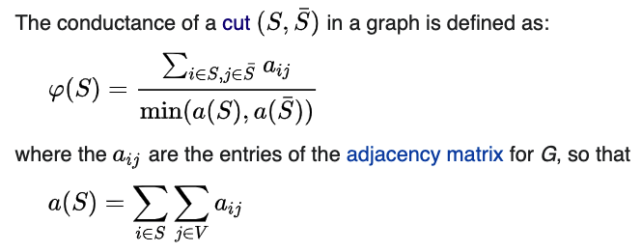
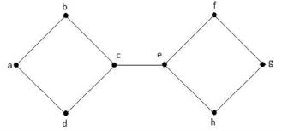
Clustering on the KNN graph to define cell populations (Spectral clustering)
Find the cuts with minimum conductance that partition the graph

Slide 23
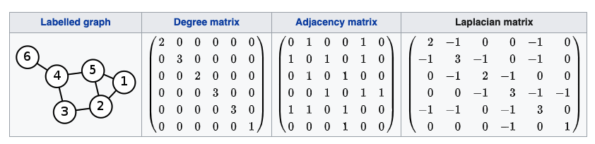
Clustering on the KNN graph to define cell populations (Spectral clustering)
Step1: Computing a specific representation (Laplacian matrix) of graph

Slide 24
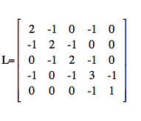
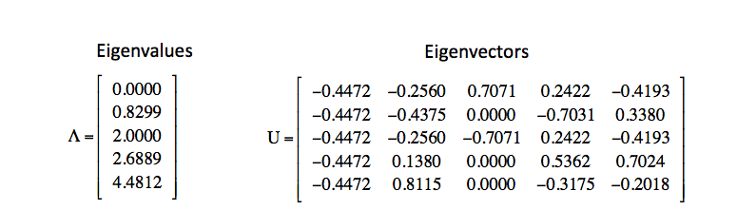
Clustering on the KNN graph to define cell populations (Spectral clustering)
Step2: Eigen decomposition of the Laplacian matrix to approximate the optimal cut
If sorted the eigenvalues and map them to its associated vertex, cut based on the second least of eigenvalues can guarantee that the conductance is at most 2 times than the optimal cut

Slide 25
Clustering on the KNN graph to define cell populations (Spectral clustering)

Slide 26
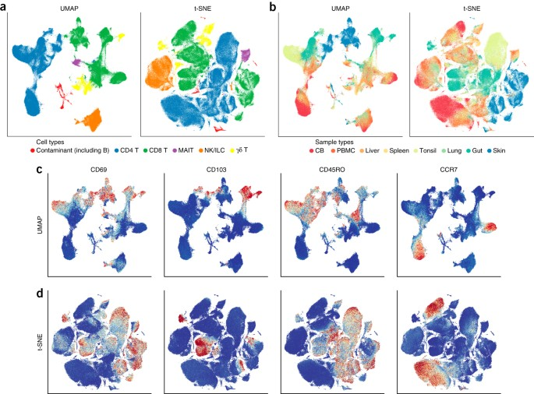
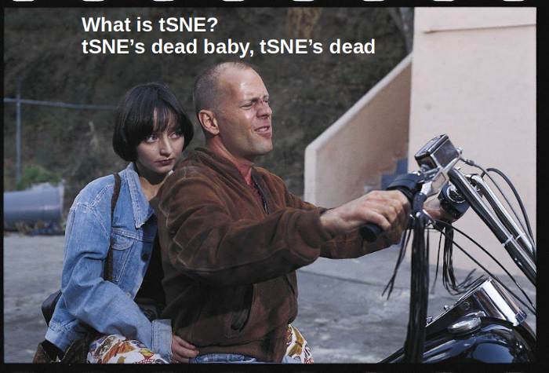
Further dimension reduction – From PCA (30 or so) to 2-3 dimension
t-sne: t-distributed Stochastic Neighbor Embedding
UMAP: Uniform Manifold Approximation and Projection

Slide 27
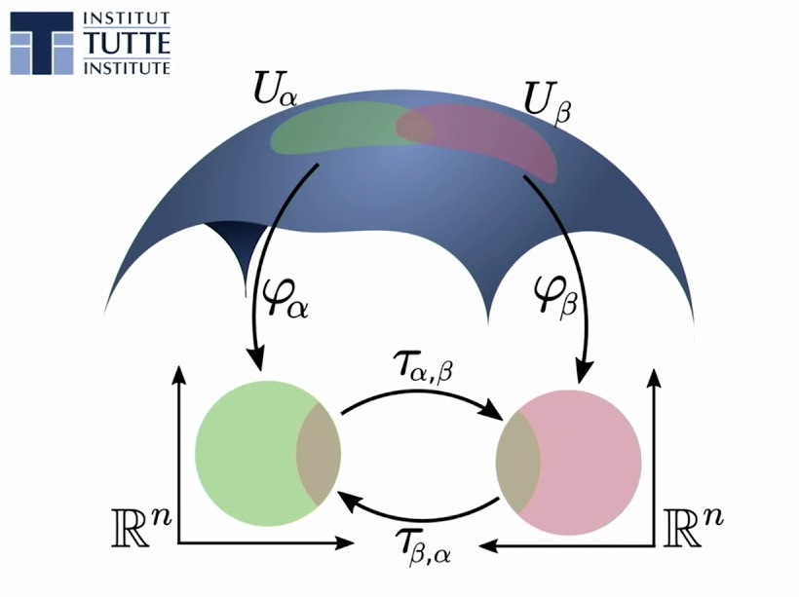
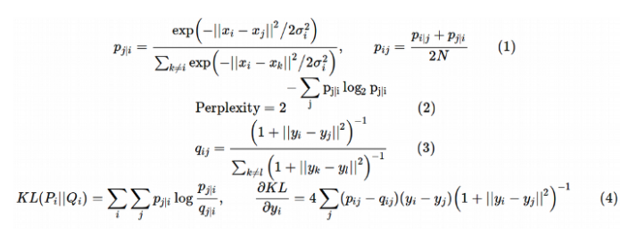
Both t-SNE and UMAP – learning a mapping from high-dimension to low
Cells that are similar in the high-dimension space should be similar in the low-dimension space as well

Slide 28
Summary
Main characteristics:
Sparsity
High dimension
Imputation method
Dimension reduction (PCA, UMAP, t-SNE)
Neighbor graph and spectral clustering
What’s next? (hands-on workshop on single-cell analysis)

